Slide 1

Remote Event Receiver Manager – SPFx sample
Dan Toft
@Tanddant
Notes:
Dan Toft
Microsoft 365 & SharePoint Specialist
Evobis, Denmark

Slide 2
About this demo
Demo & Why I made this sample
What is a Remote Event Receiver
Remote event receivers vs. Power Automate
Notes:
RERs added with app-only don’t work w/o app-only principal with tenant permissions. aka PnP.Powershell
No documentation on the REST api with RERs
FOCUS ON LISTS

Slide 3
Demo

Slide 4
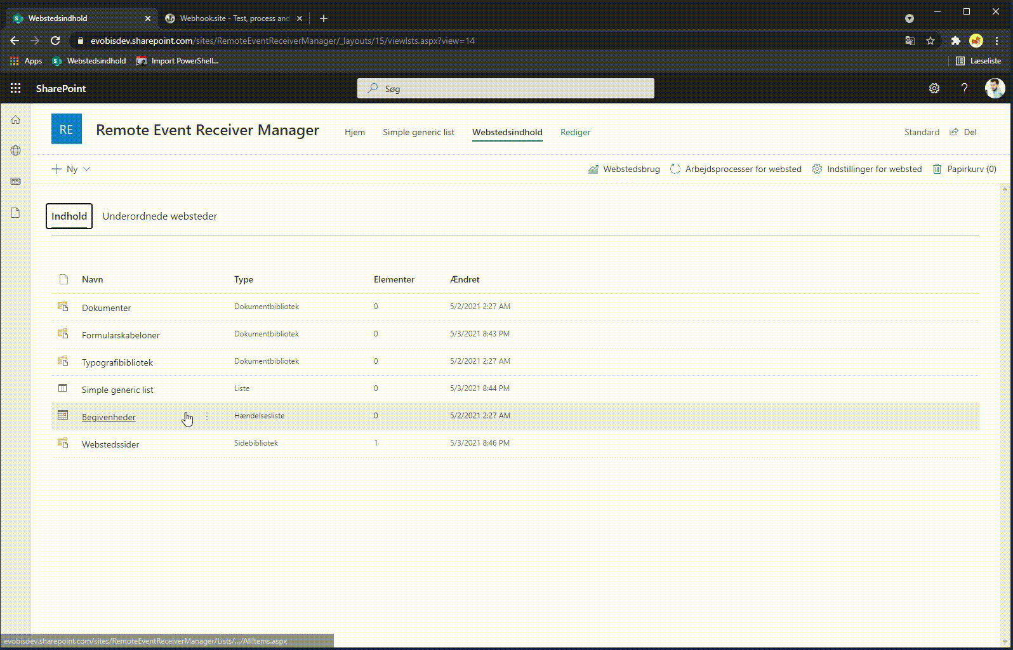
Take screen shots of your demo as a backup

Slide 5
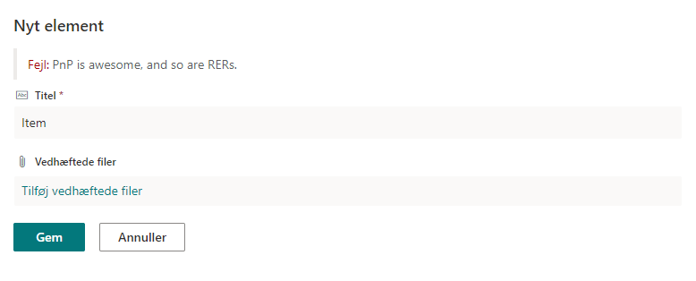
Take screen shots of your demo as a backup

Slide 6
What is a Remote Event Receiver

Slide 7






Write back to the list (advanced calculated fields)
Send data to external services
Validate or get data from external services
What is an Remote Event Receiver

Slide 8
Remote Event Receivers vs. Power Automate

Slide 9



Notes:
Function is not the only place!
Can be done in Power Automate but you lose some of the “help” and “user-friendliness”

Slide 10
Remote Event Receivers
Pros:
Reusability
Synchronous and asynchronous
Instant
“Unlimited power”
CSOM
PnP.Framework
Third Party Integrations without custom actions
Cons:
Code
Needs hosting
Harder to “see”
No retry handling/logging
Azure queue
Black box
Notes:
Reusable if built correctly
Webhooks have 5 minutes of delay, and expire – but can be more “secure”
Especially if you're not the original developer

Slide 11
Thank you!
Remote Event Receiver Manager:
https://github.com/pnp/sp-dev-fx-webparts/tree/main/samples/react-remote-event-receiver-manager
SPFx
https://aka.ms/spfx-webparts
Remote Event Receivers
https://docs.microsoft.com/en-us/sharepoint/dev/solution-guidance/use-remote-event-receivers-in-sharepoint
@Tanddant

